Slide 1
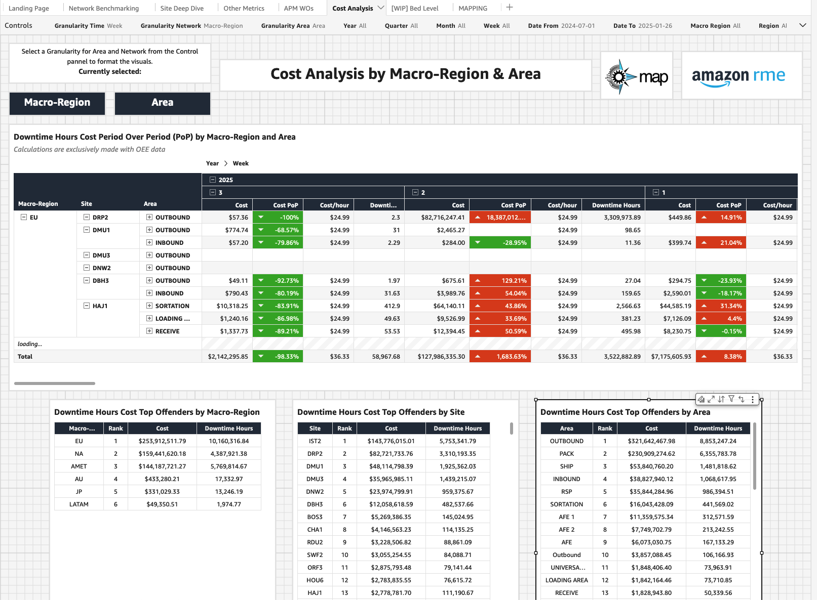
Global RME Jam Program
Cost Analysis of Jam’s Dashboard Strategy
Purpose: To develop a comprehensive, real-time dashboard tracking the financial impact of equipment jams across Amazon's network, enabling data-driven decisions for operational efficiency and cost reduction.
Key Objectives:
Provide immediate visibility into jam-related costs
Enable proactive maintenance decisions
Track ROI of jam reduction initiatives
Quantify financial impact of Global Jam Program interventions
Location & Integration:
Hosted as a dedicated tab within the existing faults dashboard. Integrated with APM and financial data systems
Expected Benefits:
The dashboard will provide unprecedented visibility into jam-related costs across our network, enabling precise tracking of return on investment for improvement initiatives. This transparency will optimize our resource allocation decisions and help identify the most cost-effective solutions for jam reduction. By implementing this dashboard, maintenance teams will be able to plan interventions more strategically, targeting the areas with the highest impact on costs and performance. The ability to quickly identify problem areas and benchmark performance across sites will drive continuous improvement in our jam reduction efforts. Our data-driven approach will revolutionize decision-making processes across the network. Through standardized metrics and comprehensive tracking, we can quantify best practices and ensure consistent improvement methodologies across all facilities. This systematic approach will support our long-term goal of reducing jam-related costs and improving operational efficiency.
Next Steps:
1. Stakeholder alignment meetings
2. Data source verification
3. Formula development with Alan's team
4. Quick Sight dashboard prototype
5. Pilot testing and refinement
Phase 3: Feature Implementation:
1. Jam frequency tracking
2. Cost impact analysis
3. Maintenance data integration
4. Location-based comparisons
Example:
This initiative aligns with Amazon's operational excellence principles and provides a foundation for network-wide jam cost reduction efforts.
Project Owner: Global Jam Program Target Implementation Date: Q1 2025

